Slide 1
Use Cases of Anaconda
SURP 2023 Python Bootcamp
Ohio State Astronomy
Slides by: Joy Bhattacharyya

Slide 2
scipy
Optimization (scipy.optimize)
Integration (scipy.integrate)
Interpolation (scipy.interpolate)
Fourier Transforms (scipy.fft)
Signal Processing (scipy.signal)
Linear Algebra (scipy.linalg)
Spatial data structures and algorithms (scipy.spatial)
Statistics (scipy.stats)
Multidimensional image processing (scipy.ndimage)

Slide 3
astropy
Units and Quantities (astropy.units)
Constants (astropy.constants)
Data Tables (astropy.table)
Time Series (astropy.timeseries)
Astronomical Coordinate Systems (astropy.coordinates)
World Coordinate System (astropy.wcs)
FITS File Handling (astropy.io.fits)
Cosmological Calculations (astropy.cosmology)
Astrostatistics Tools (astropy.stats)

Slide 4
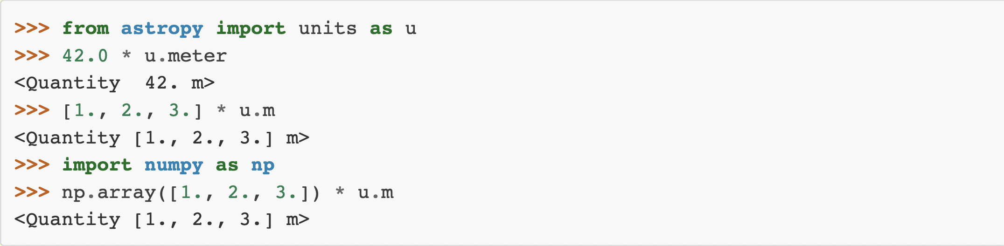
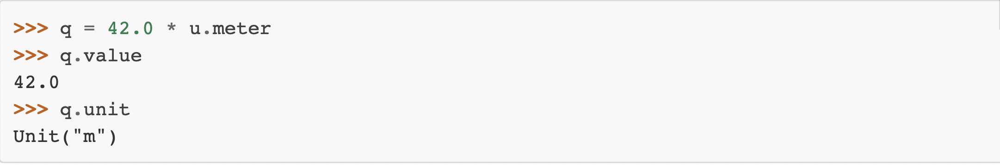
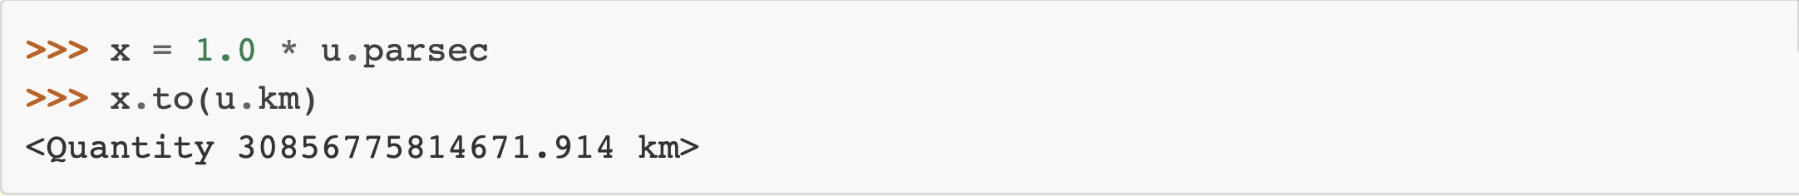
astropy.units
handles defining, converting between, and performing arithmetic with physical quantities
also handles logarithmic units such as magnitude and decibel.
Quantity objects: the combination of a value and a unit.

Slide 5
Unit | Description
adu | adu
AU | astronomical unit
beam | beam
bin | bin
chan | chan
ct | count (ct)
DN | dn (DN)
earthMass | Earth mass
earthRad | Earth radius
electron | Number of electrons
jupiterMass | Jupiter mass
jupiterRad | Jupiter radius
Jy | Jansky: spectral flux density
lsec | Light second
lyr | Light year
pc | parsec: approximately 3.26 light-years.
ph | photon (ph)
R | Rayleigh: photon flux
Ry | Rydberg: Energy of a photon whose wavenumber is the Rydberg constant
solLum | Solar luminance
solMass | Solar mass
solRad | Solar radius

Slide 6
G | 6.6743e-11 | m3 / (kg s2) | GRAVITATIONAL CONSTANT
N_A | 6.02214076e+23 | 1 / (mol) | AVOGADRO’S NUMBER
R | 8.31446262 | J / (K mol) | GAS CONSTANT
Ryd | 10973731.6 | 1 / (m) | RYDBERG CONSTANT
a0 | 5.29177211e-11 | m | BOHR RADIUS
alpha | 0.00729735257 |  | FINE-STRUCTURE CONSTANT
atm | 101325 | Pa | STANDARD ATMOSPHERE
b_wien | 0.00289777196 | m K | WIEN WAVELENGTH DISPLACEMENT LAW CONSTANT
c | 299792458 | m / (s) | SPEED OF LIGHT IN VACUUM
e | 1.60217663e-19 | C | ELECTRON CHARGE
eps0 | 8.85418781e-12 | F/m | VACUUM ELECTRIC PERMITTIVITY
g0 | 9.80665 | m / s2 | STANDARD ACCELERATION OF GRAVITY
h | 6.62607015e-34 | J s | PLANCK CONSTANT
hbar | 1.05457182e-34 | J s | REDUCED PLANCK CONSTANT
k_B | 1.380649e-23 | J / (K) | BOLTZMANN CONSTANT
m_e | 9.1093837e-31 | kg | ELECTRON MASS
m_n | 1.6749275e-27 | kg | NEUTRON MASS
m_p | 1.67262192e-27 | kg | PROTON MASS
mu0 | 1.25663706e-06 | N/A2 | VACUUM MAGNETIC PERMEABILITY
muB | 9.27401008e-24 | J/T | BOHR MAGNETON
sigma_T | 6.65245873e-29 | m2 | THOMSON SCATTERING CROSS-SECTION
sigma_sb | 5.67037442e-08 | W / (K4 m2) | STEFAN-BOLTZMANN CONSTANT
u | 1.66053907e-27 | kg | ATOMIC MASS

Slide 7
GM_earth | 3.986004e+14 | m3 / (s2) | NOMINAL EARTH MASS PARAMETER
GM_jup | 1.2668653e+17 | m3 / (s2) | NOMINAL JUPITER MASS PARAMETER
GM_sun | 1.3271244e+20 | m3 / (s2) | NOMINAL SOLAR MASS PARAMETER
L_bol0 | 3.0128e+28 | W | LUMINOSITY FOR ABSOLUTE BOLOMETRIC MAGNITUDE 0
L_sun | 3.828e+26 | W | NOMINAL SOLAR LUMINOSITY
M_earth | 5.97216787e+24 | kg | EARTH MASS
M_jup | 1.8981246e+27 | kg | JUPITER MASS
M_sun | 1.98840987e+30 | kg | SOLAR MASS
R_earth | 6378100 | m | NOMINAL EARTH EQUATORIAL RADIUS
R_jup | 71492000 | m | NOMINAL JUPITER EQUATORIAL RADIUS
R_sun | 695700000 | m | NOMINAL SOLAR RADIUS
au | 1.49597871e+11 | m | ASTRONOMICAL UNIT
kpc | 3.08567758e+19 | m | KILOPARSEC
pc | 3.08567758e+16 | m | PARSEC

Slide 8
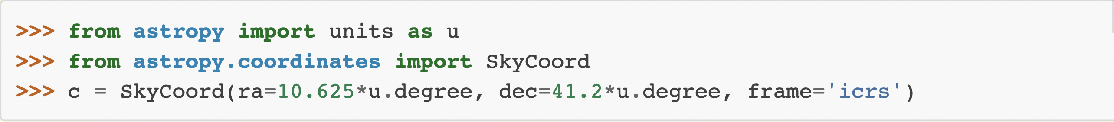
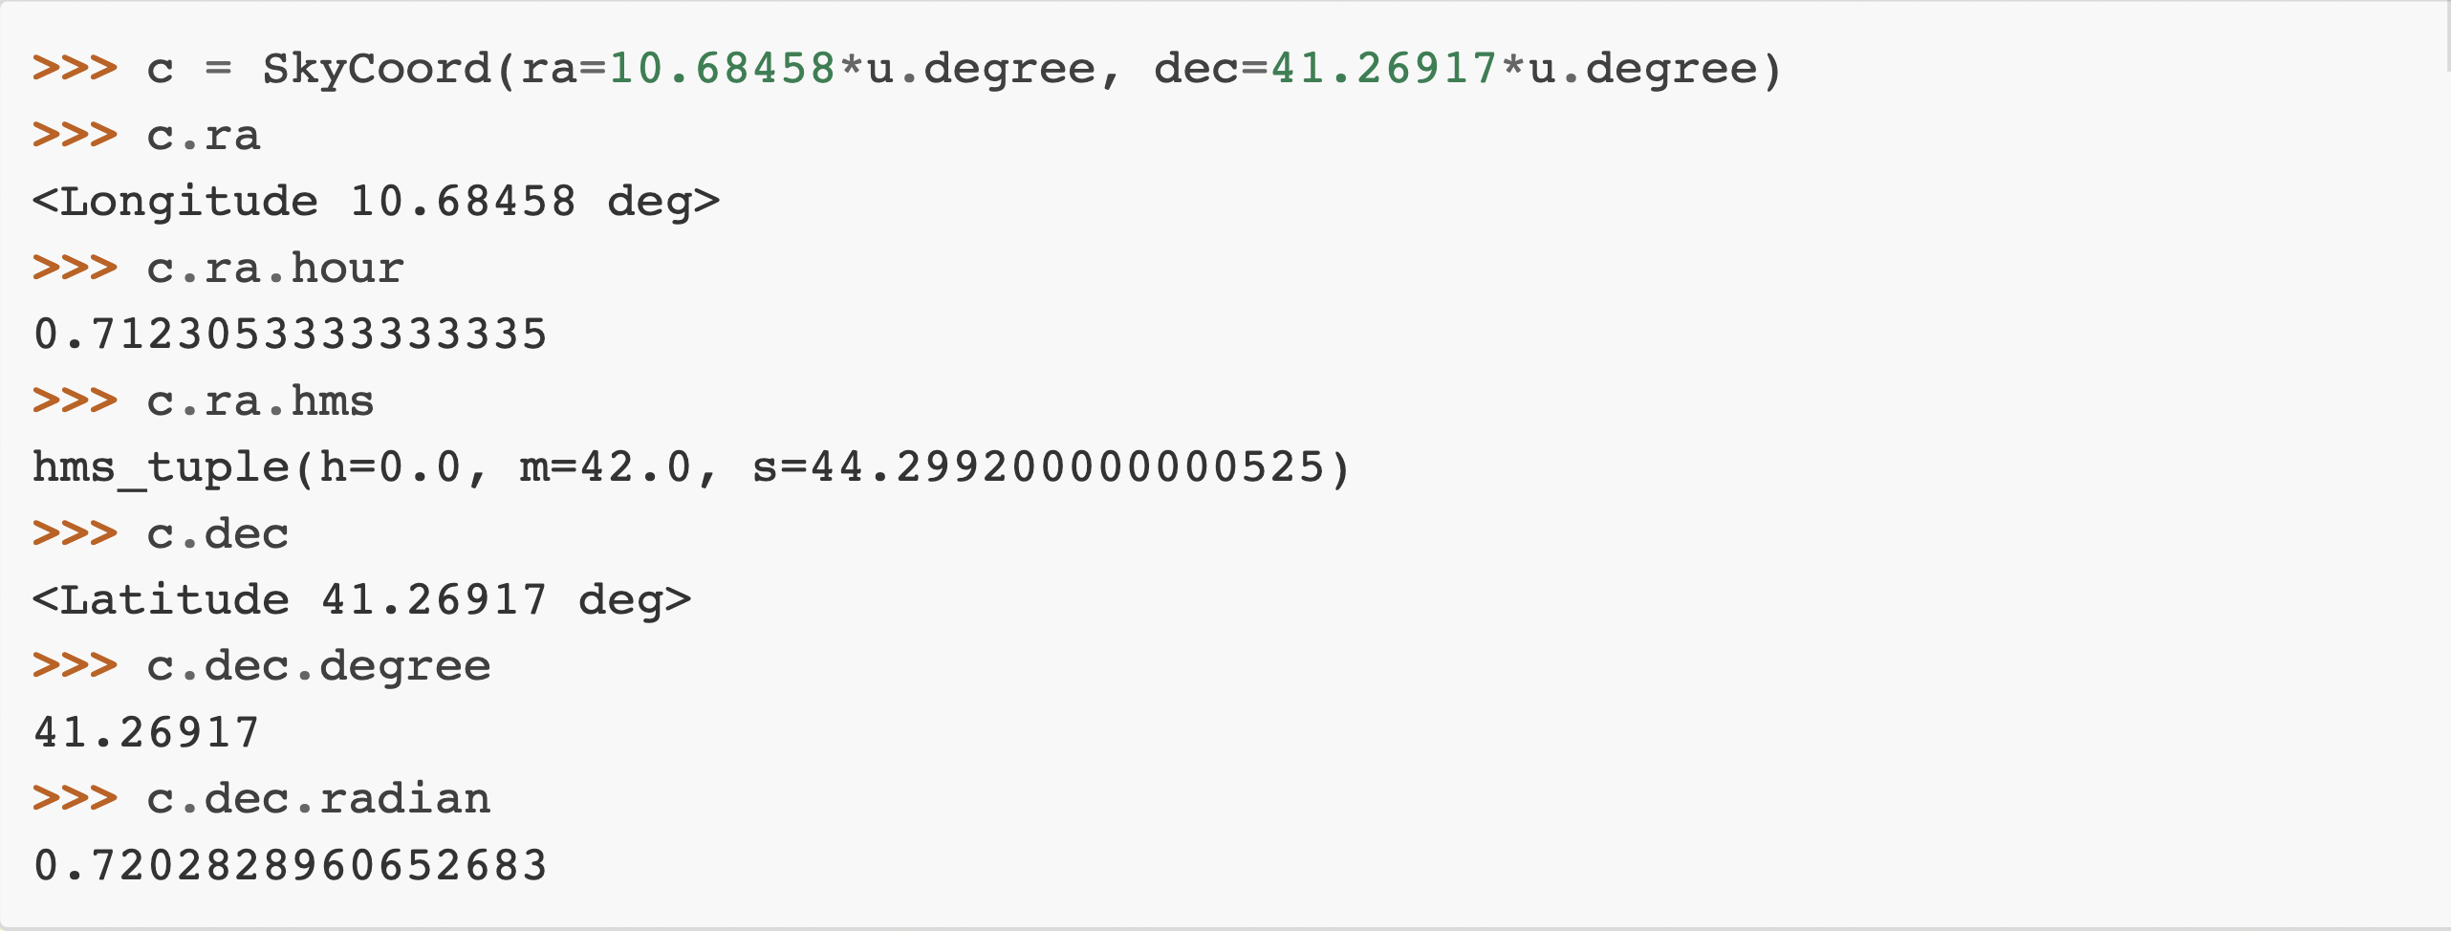
astropy.coordinates
classes for representing a variety of celestial/spatial coordinates and their velocity components
SkyCoord objects are instantiated by passing in positions with specified units and a coordinate frame (default: ICRS)

Slide 9
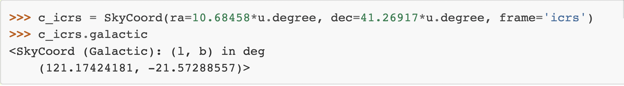
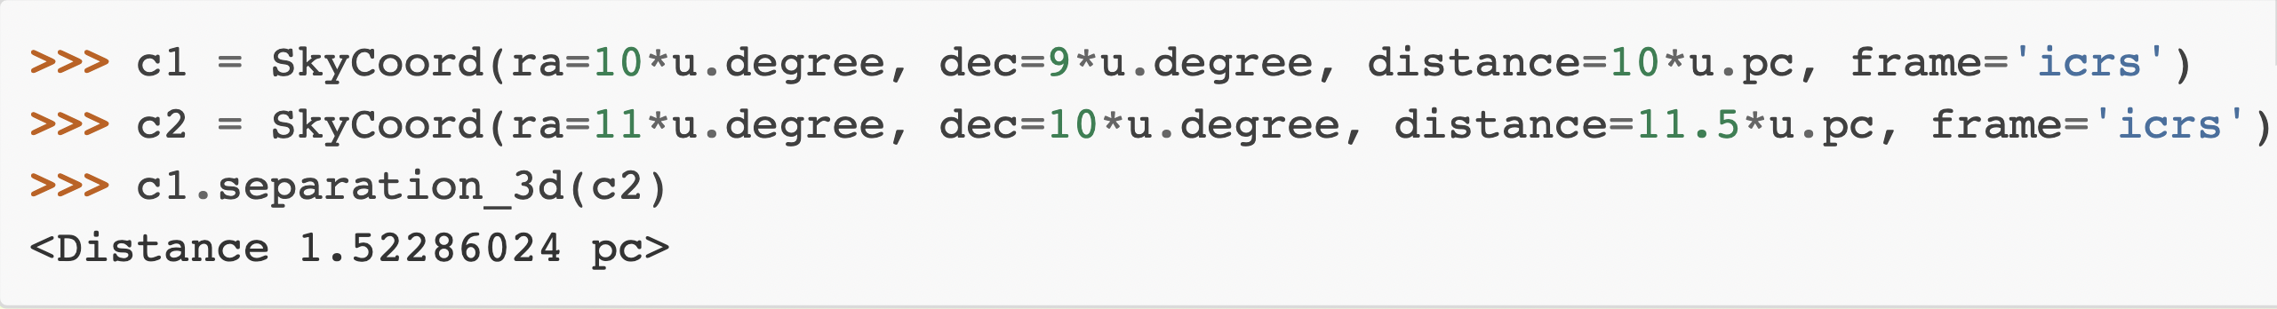
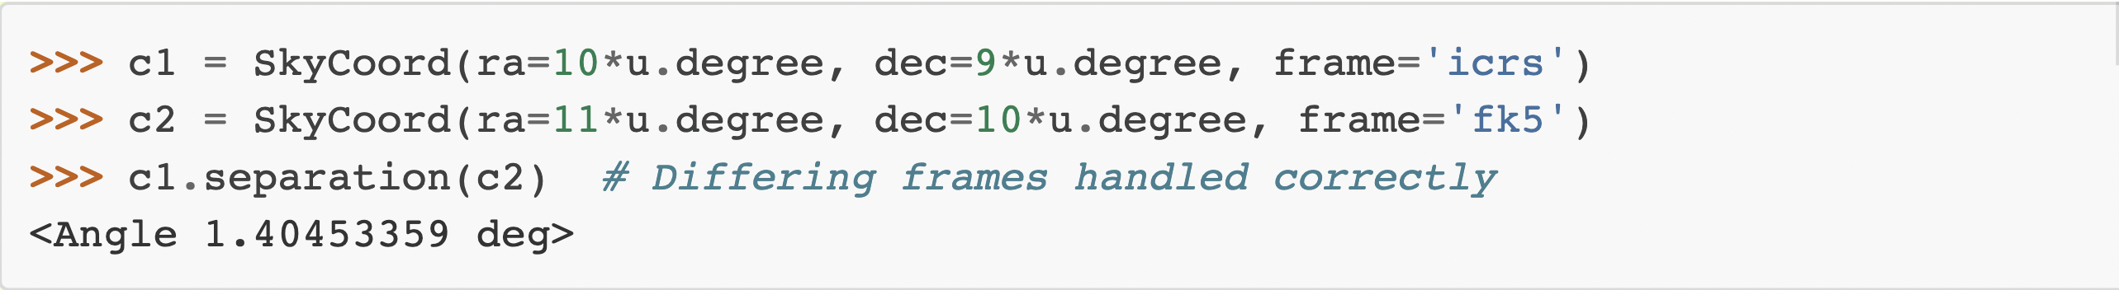
tools for converting between systems in a uniform way.
on-sky and 3D separations between two coordinates can be computed

Slide 10
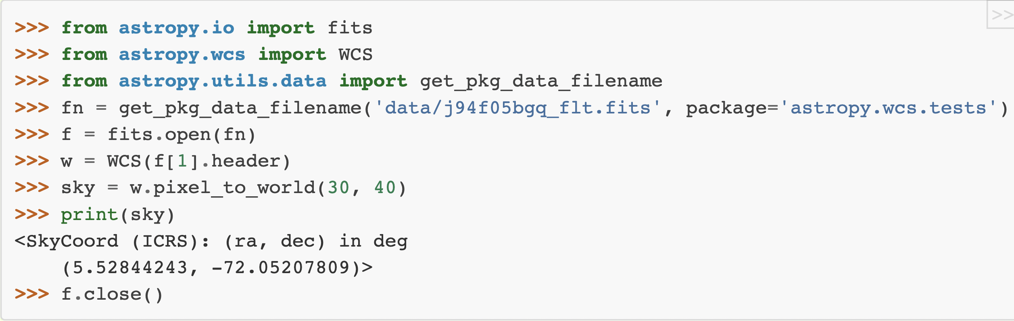
astropy.wcs
Convert between astronomical and pixel coordinates

Slide 11
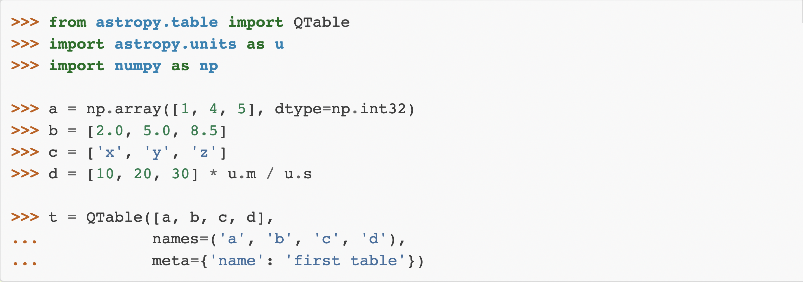
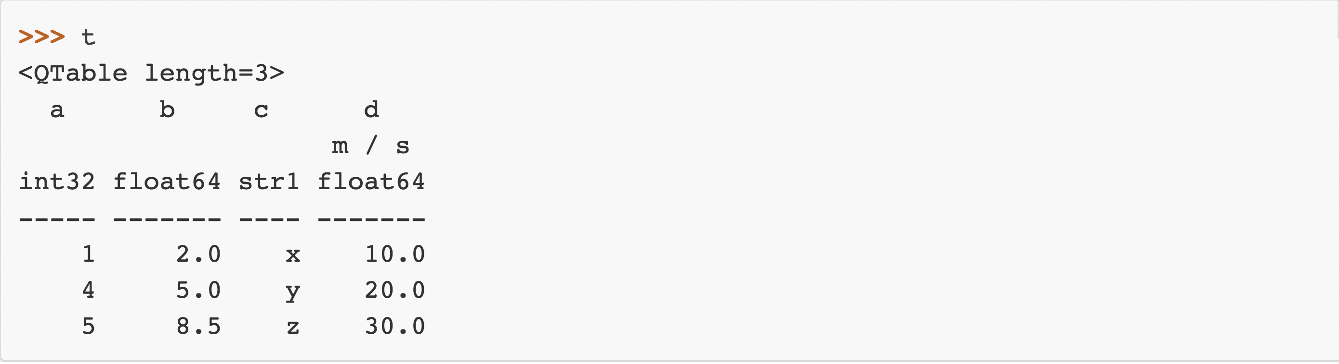
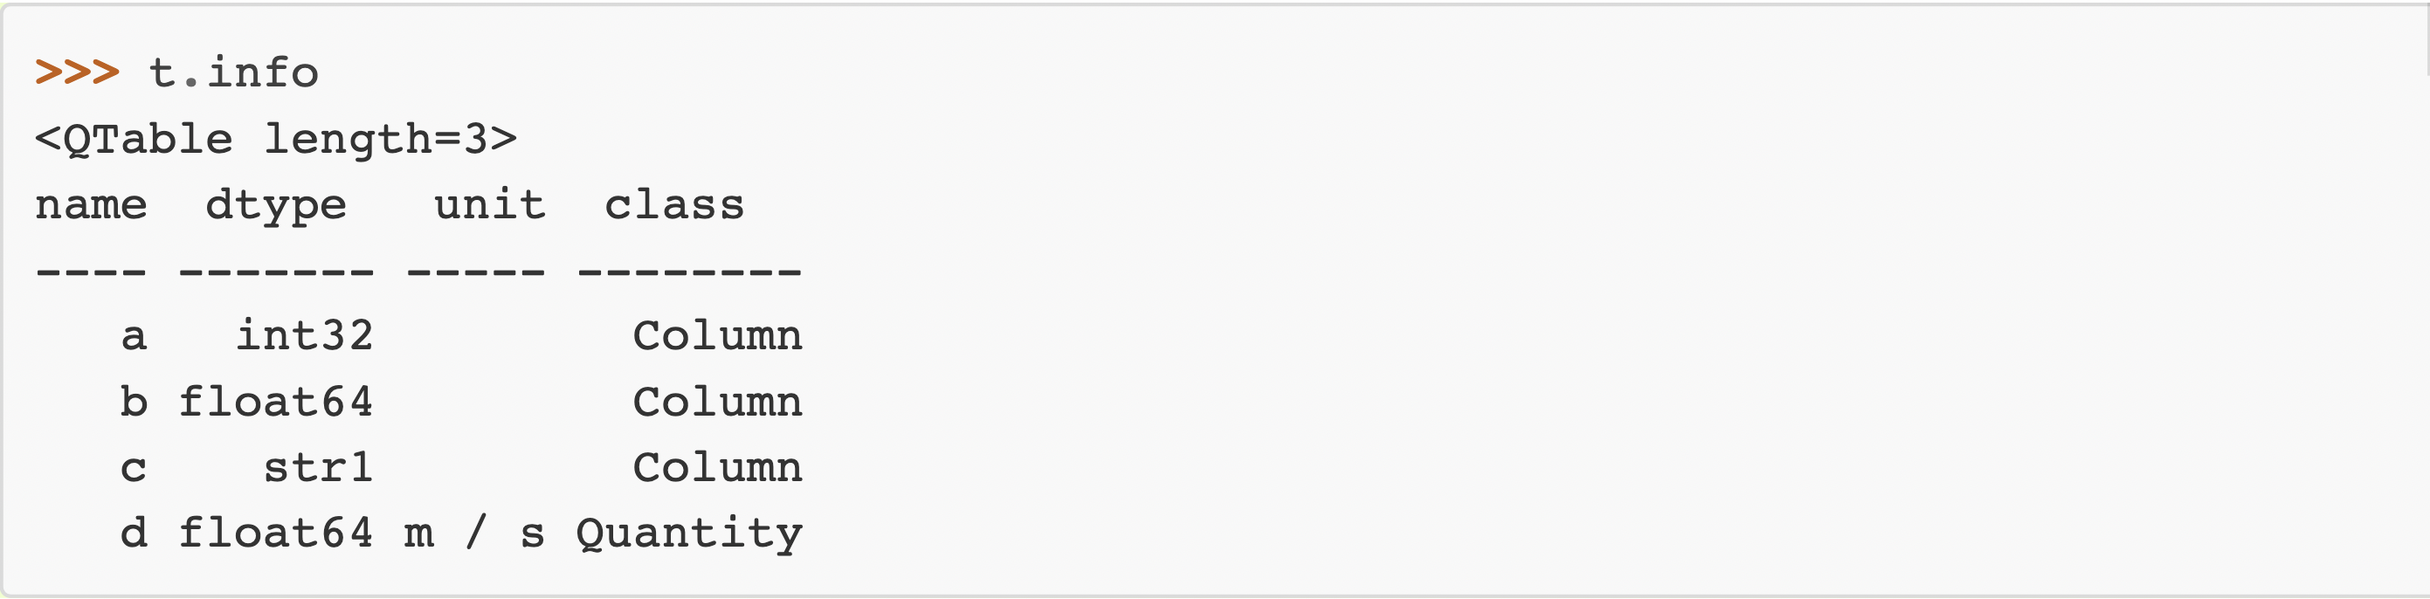
astropy.table
store and manipulate heterogeneous tables of data
specify a description, units, and output formatting for columns.
perform Table Operations like database joins, concatenation, and binning.

Slide 12
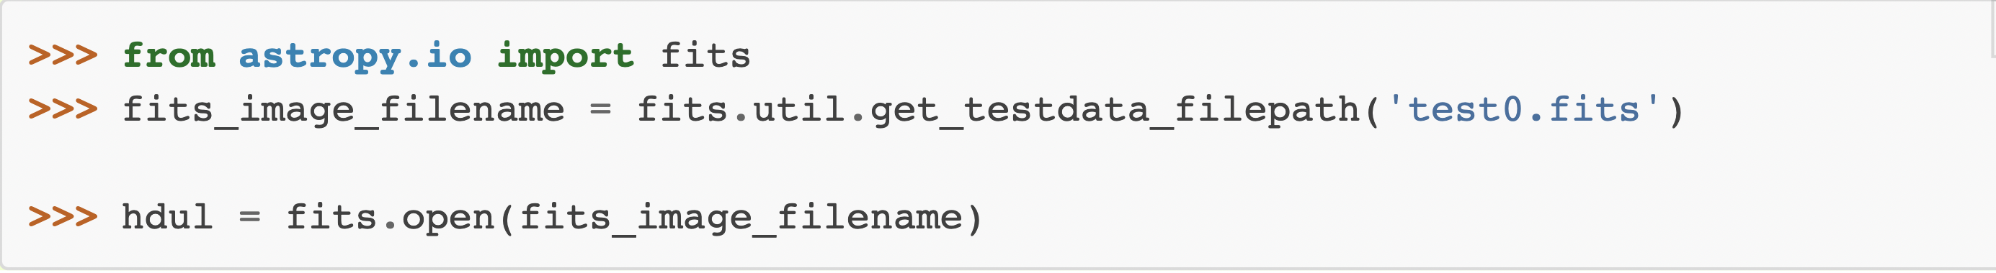
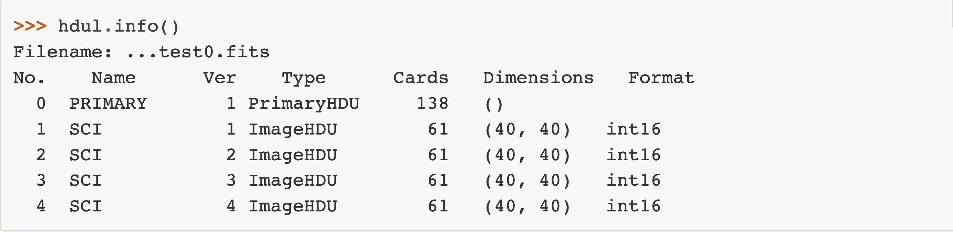
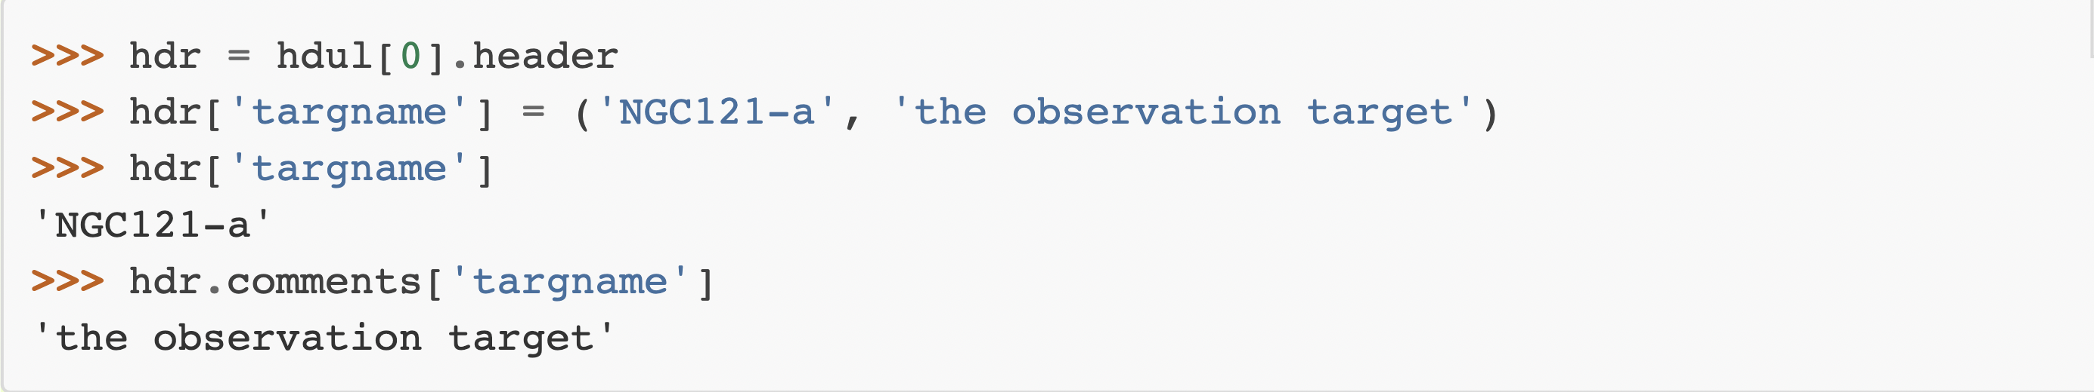
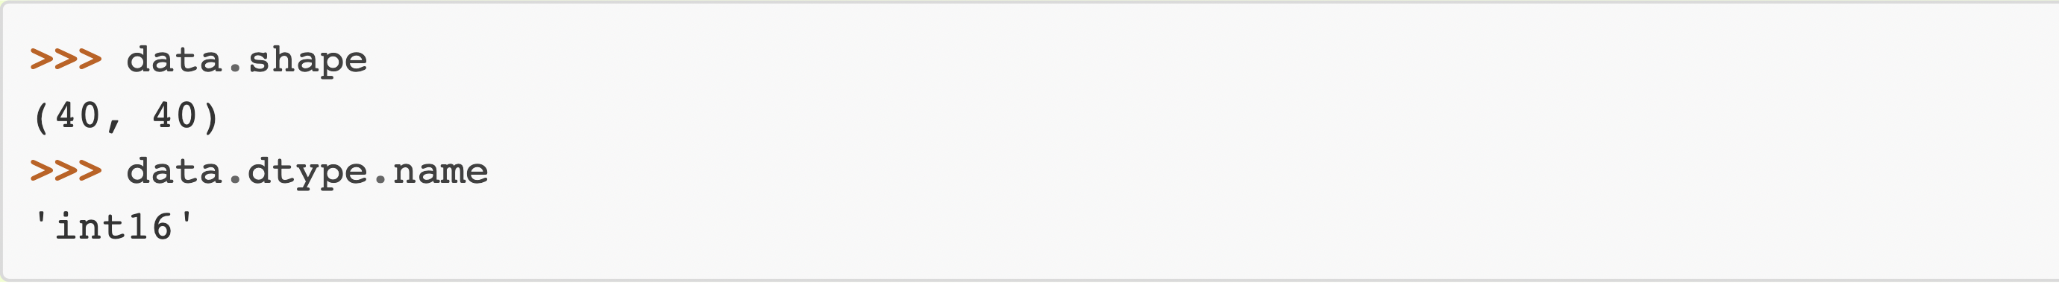
astropy.io.fits
provides access to FITS files
inspect and modify header
read image and spectrum files as numpy arrays
read and edit tables

Slide 13
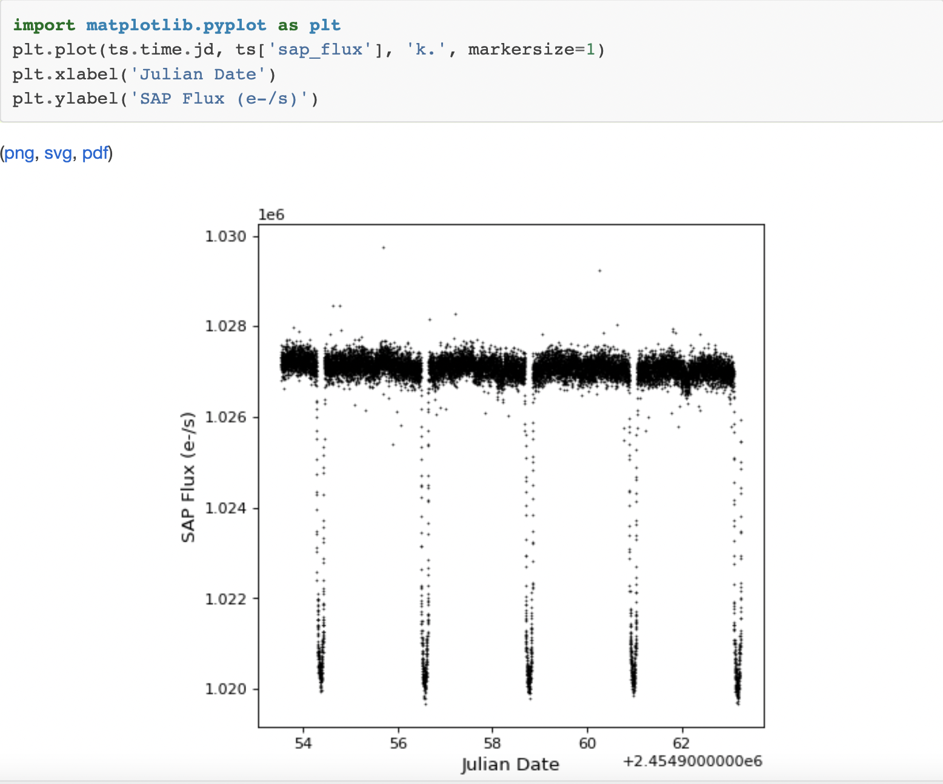
astropy.timeseries
QTable subclasses that have special columns to represent times using the Time class.
provide time series-specific functionality above and beyond Qtable- binning, folding and periodogram.

Slide 14
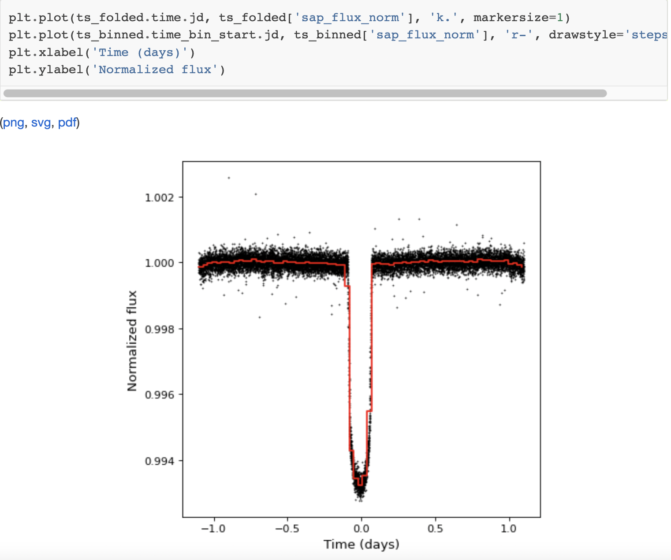

Slide 15
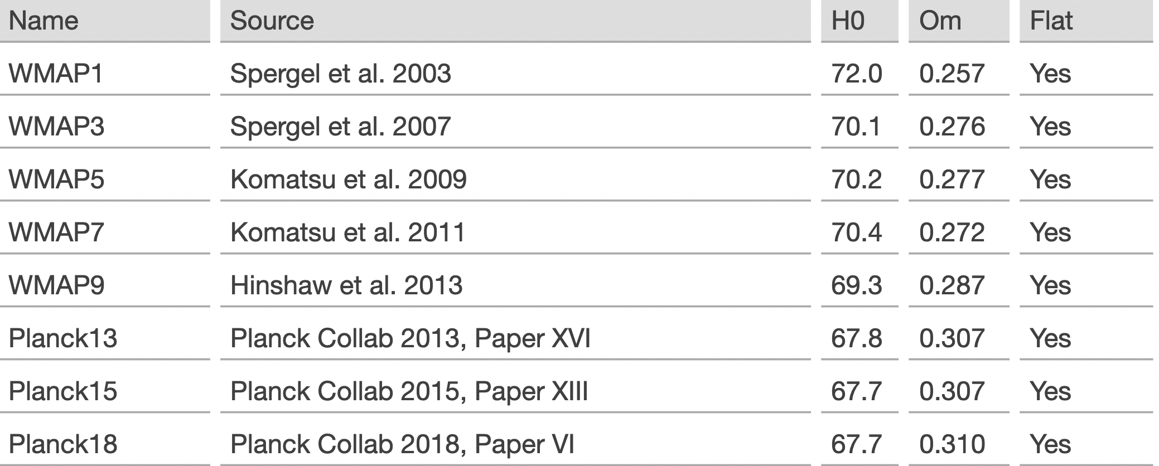
astropy.cosmology
predefined available cosmologies-

Slide 16
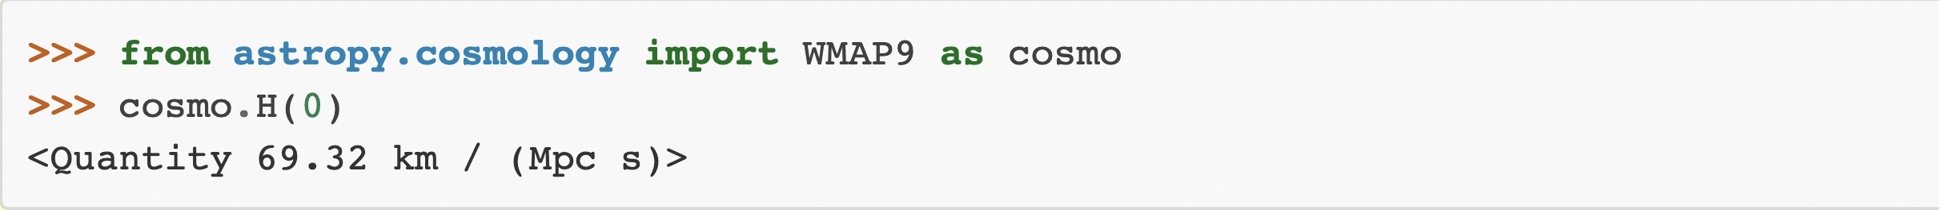
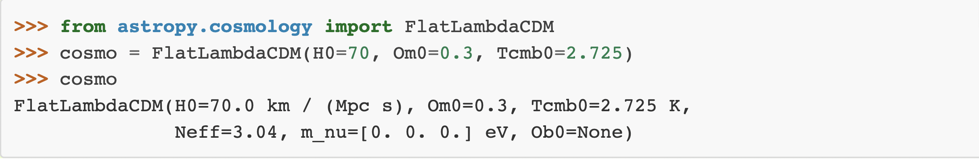
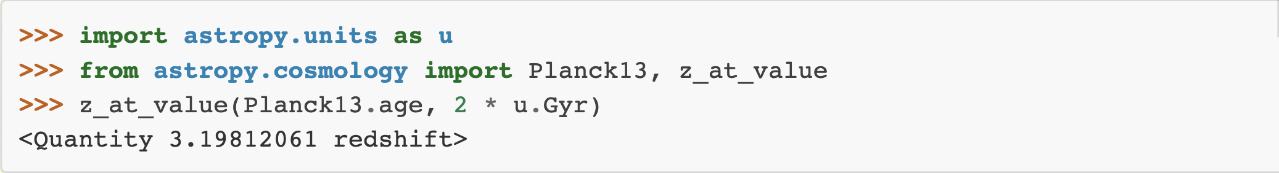
User defined FLRW-like cosmology can be created
distances, ages, and lookback times corresponding to a measured redshift
Finding the redshift at a given value of a cosmological quantity

Slide 17
astropy.stats
binom_conf_interval | Binomial proportion confidence interval given k successes, n trials.
poisson_conf_interval | Poisson parameter confidence interval given observed counts
median_absolute_deviation | Calculate the median absolute deviation (MAD).
signal_to_noise_oir_ccd | Computes the signal to noise ratio for source being observed in the optical/IR using a CCD.
bootstrap | Performs bootstrap resampling on numpy arrays.
cdf_from_intervals | Construct a callable piecewise-linear CDF from a pair of arrays.
interval_overlap_length | Compute the length of overlap of two intervals.
histogram_intervals | Histogram of a piecewise-constant weight function.
fold_intervals | Fold the weighted intervals to the interval (0,1).
sigma_clip | Perform sigma-clipping on the provided data.
sigma_clipped_stats | Calculate sigma-clipped statistics on the provided data.
jackknife_resampling | Performs jackknife resampling on numpy arrays.
jackknife_stats | Performs jackknife estimation on the basis of jackknife resamples.
rayleightest | Performs the Rayleigh test of uniformity.
vonmisesmle | Computes the Maximum Likelihood Estimator (MLE) for the parameters of the von Mises distribution.
bayesian_blocks | Compute optimal segmentation of data with Scargle’s Bayesian Blocks
histogram | Enhanced histogram function, providing adaptive binnings
calculate_bin_edges | Calculate histogram bin edges like numpy.histogram_bin_edges.
bayesian_info_criterion | Computes the Bayesian Information Criterion (BIC) given the log of the likelihood function evaluated at the estimated parameters, the number of parameters, and the number of samples.
akaike_info_criterion | Computes the Akaike Information Criterion (AIC).

